Slide 1

International Conference on Smart Systems for applications in Electrical Sciences ICSSES-2024
Siddaganga Institute of Technology, Tumakuru
Association of Electrical Sciences
“RSA IMPLEMENTATION USING FPGA”
By
NITIN SINGH
Date:04/05/2024
Paper ID:395

Slide 2
Contents
Introduction
Literature Review
Methodology
Test, Results and Discussion
Conclusion
Reference

Slide 3
Introduction
Problem Statement: Achieving efficient and secure encryption/decryption is essential. RSA, a key algorithm, is slow when executed on software, especially with significant data or real-time demands. A hardware-based approach is required to accelerate RSA computations for better performance and effectiveness.
RSA is a cryptographic algorithm that provides data authentication and security. Two sets of keys are used i.e. Public key and private key on encryption and decryption side (public key on encryption and private key on decryption side).
Plain text is converted/encrypted into cipher text using public key on the encryption side or senders’s side while this cipher text is again converted/decrypted using private key on decryption side i.e. receiver’s side.

Slide 4
Literature Review

Slide 5
Methodology
The RSA cryptosystem can be explained in only a few steps: prime number generation, key generation, encryption, and decryption.
The RSA cryptosystem is based on two large prime numbers 𝑝, 𝑞 chosen at random at a set bit length such that p!= q and the multiplication of these numbers generate 𝑛 = 𝑝*𝑞. We then calculate 𝑝ℎ𝑖(𝑛) = (𝑝 −1)(𝑞− 1).
We then choose a public key(e) such that 1 <𝑒<𝑝ℎ𝑖(𝑛) and such that e is not divisible by 𝑝ℎ𝑖(𝑛). After this we can calculate the public key such that 𝑔cd(𝑝h𝑖(𝑛), 𝑒) = 1 (where e and phi(n) are relative primes.) We can then calculate our private key d such that 𝑑 =𝑒^(-1) 𝑚od (𝑝ℎ𝑖(𝑛)) .We choose a message m to generate a cipher text c such that 𝑐=𝑚^𝑒 𝑚od (𝑛) and decrypt our cipher to generate our original message m such that 𝑚=𝑐^𝑑 𝑚od(𝑛).

Slide 6
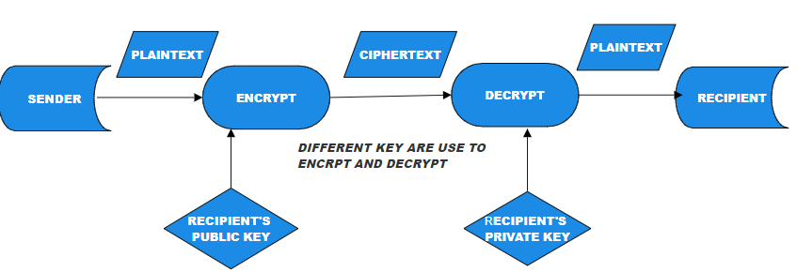
Workflow and key formatting

Slide 7
Methodology
Key generation:
- Choose two large prime numbers, p and q.
- Compute n = p * q, which is the modulus.
- Compute the totient function, φ(n) = (p-1) * (q-1).
- Choose a number e, such that 1 < e < φ(n) and gcd(e, φ(n)) = 1 (e is the public key).
- Compute d, such that d * e ≡ 1 (mod φ(n)) (d is the private key).
Encryption:
- Given a plaintext message, M, to be encrypted, compute:
- Ciphertext, C = M^e (mod n)
Decryption:
- Given a ciphertext, C, to be decrypted, compute:
- Plaintext, M = C^d (mod n)

Slide 8
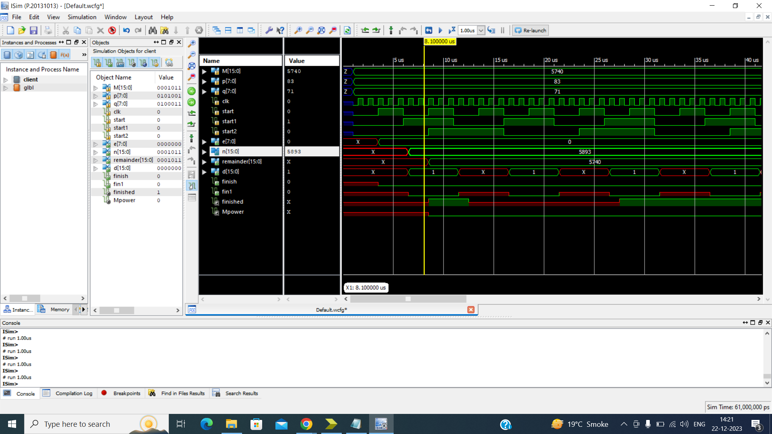
Test, Results and Discussion
Encryption (Client.v)

Slide 9
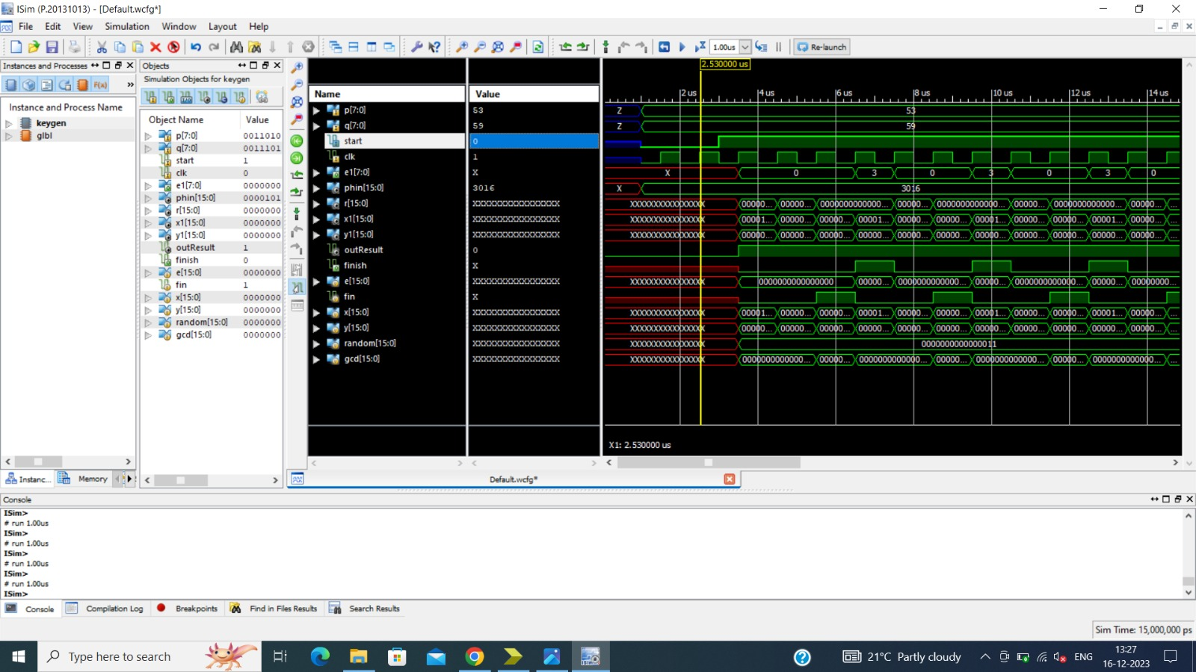
Test, Results and Discussion
Key Generation(Public key)

Slide 10
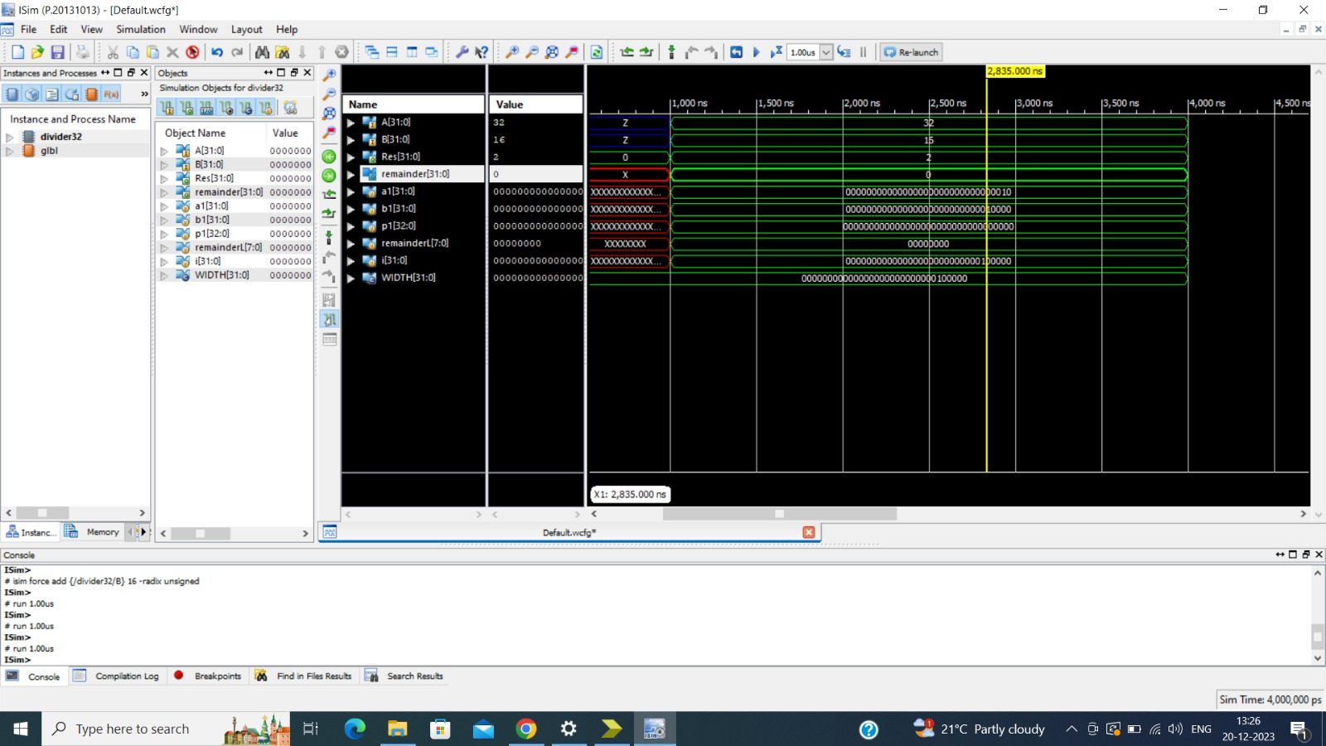
Test, Results and Discussion
Divider 32 bits

Slide 11
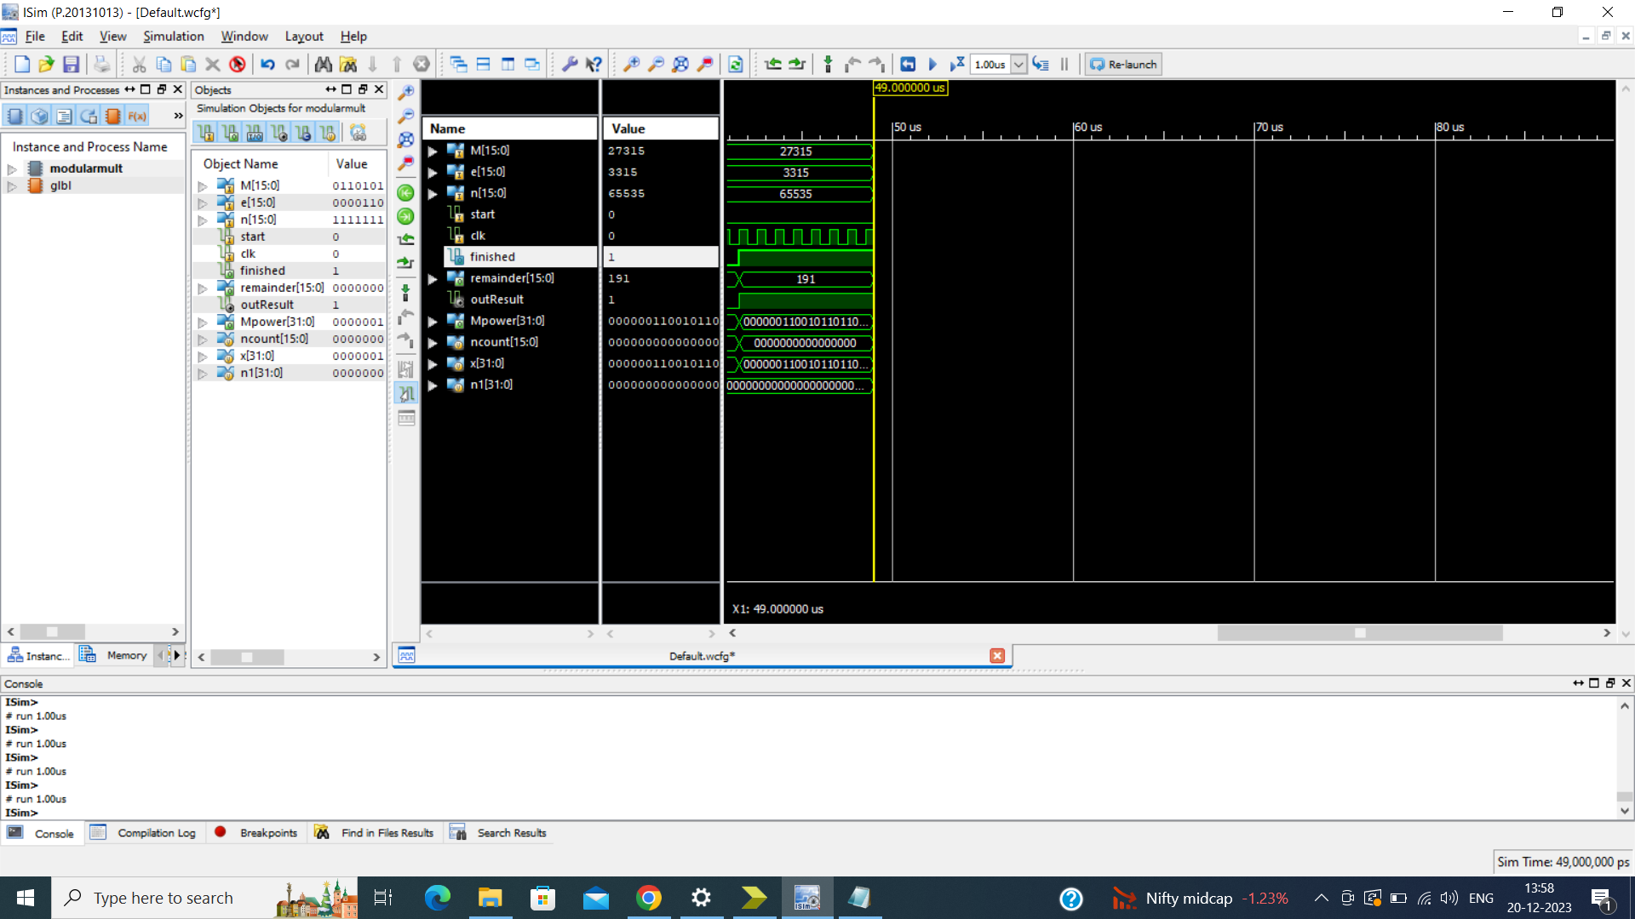
Test, Results and Discussion
Modulo Multiplication

Slide 12
Test, Results and Discussion
DECRYPTION(Private key(dnew.v/data received)

Slide 13
Conclusion

Slide 14
References
https://ieeexplore.ieee.org/document/6021216
https://iopscience.iop.org/article/10.1088/1742-6596/1641/1/012042
https://scholarworks.calstate.edu/concern/theses/76537633k?locale=en
https://www.ijser.org/researchpaper/Implementation_of_RSA_Cryptosystem_Using_Verilog.pdf
https://www.ijert.org/research/implementation-of-rsa-algorithm-on-fpga-IJERTV1IS5454.pdf
https://www.researchgate.net/publication/257416064_Cryptosystem_An_Implementation_of_RSA_Using_Verilog

